Slide 1
INTRODUCTION OF
DATA SCIENCE

Slide 2
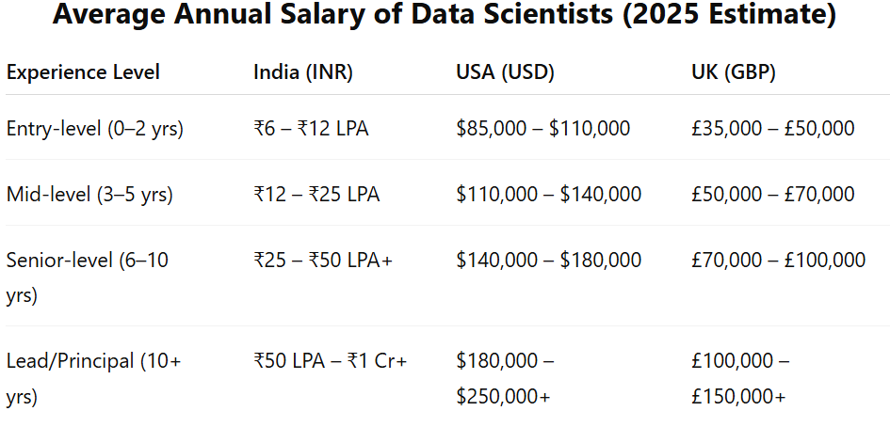

Slide 3
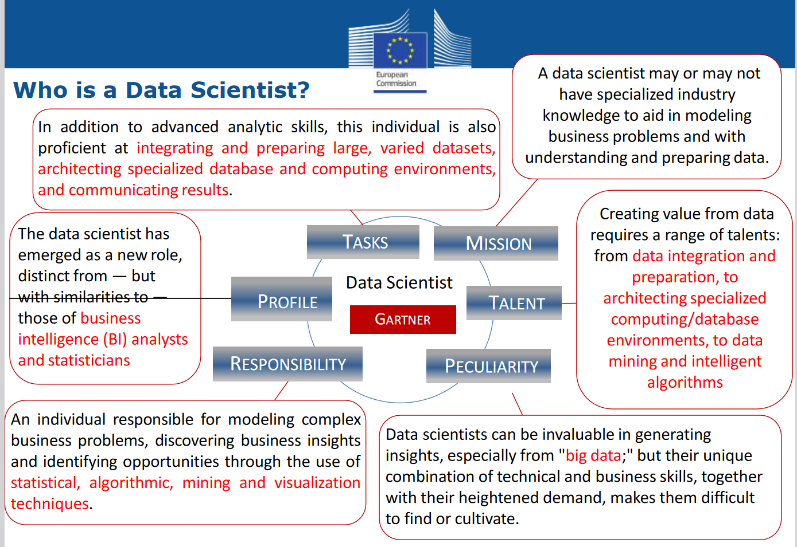

Slide 4
About Data Science
Data science is an interdisciplinary field that uses scientific methods, processes, algorithms, and systems to extract knowledge and insights from structured and unstructured data. It involves a combination of skills from various domains, including statistics, computer science, information technology, and domain expertise.
Key Components of Data Science:
Data Collection: Gathering raw data from various sources such as databases, web scraping, sensors, or manual entry.
Data Cleaning: Preparing the data by handling missing values, correcting errors, and ensuring consistency.
Data Exploration and Visualization: Analyzing data to understand its main characteristics, often using statistical graphics, plots, and information graphics.
Data Analysis: Applying statistical and machine learning techniques to identify patterns, correlations, and insights. This may include regression analysis, classification, clustering, and more.
Model Building: Developing predictive or descriptive models using algorithms and training them on data.
Communication: Presenting the findings and insights to stakeholders using visualizations, reports, and dashboards to inform decision-making.
Deployment: Implementing the models in a production environment where they can be used for real-time predictions or decision support.

Slide 5
Importance of Data Science
Drives decision-making
Enhances business intelligence
Enables predictive analytics
Facilitates automation
Supports innovation

Slide 6
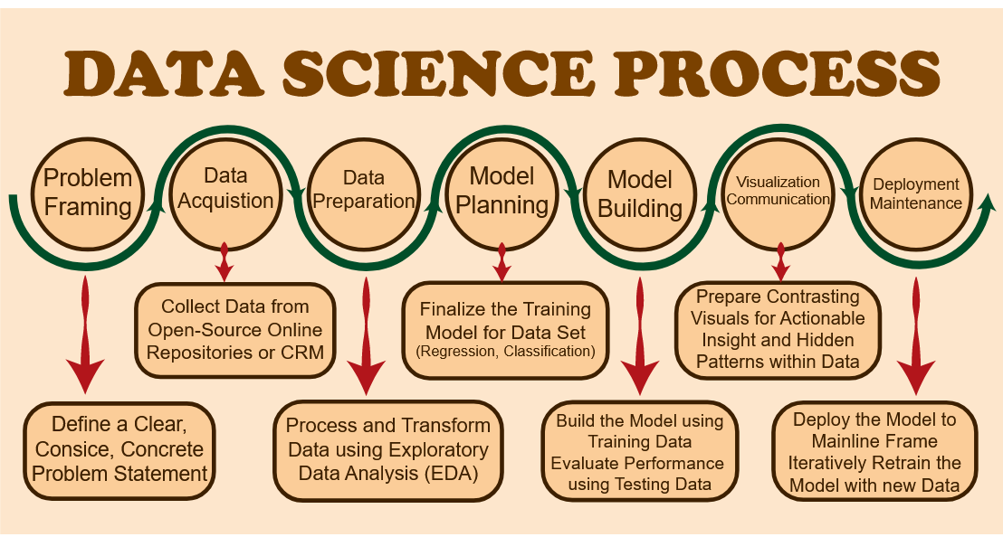
Data Science Process

Slide 7
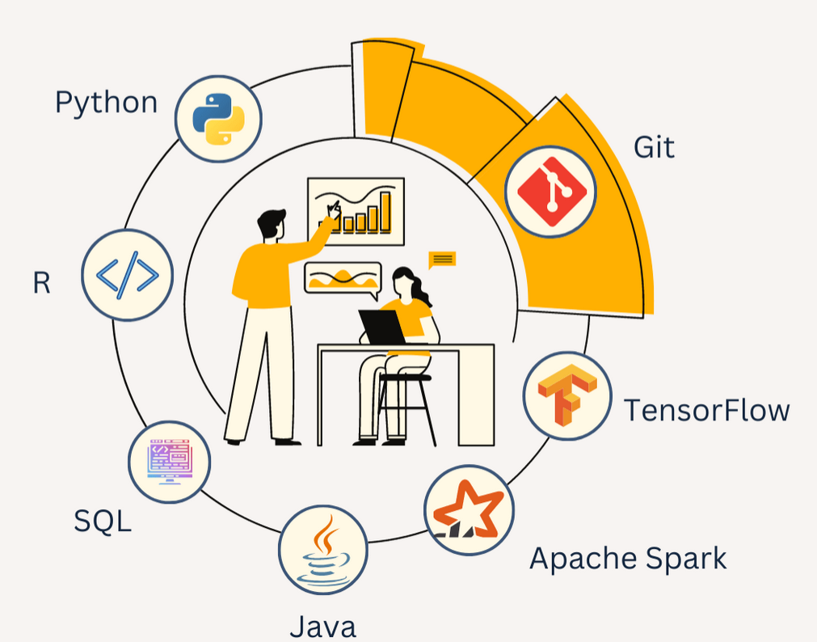
Top 7 Data Science Tools

Slide 8
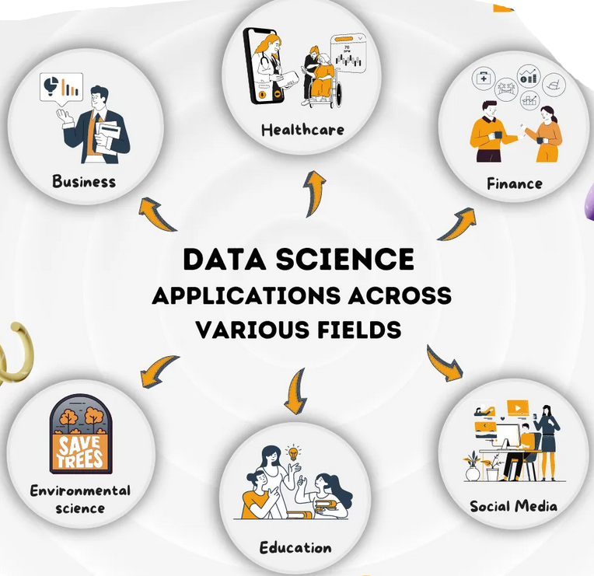
Applications of Data Science
Industries:
Healthcare: Predictive diagnostics, personalized medicine
Finance: Fraud detection, risk management
Marketing: Customer segmentation, targeted advertising
Retail: Inventory optimization, customer insights
Technology: Recommendation systems, speech recognition

Slide 9
Data Science Case Studies
Case Study 1: Healthcare - Predictive Diagnostics
Case Study 2: Finance - Fraud Detection
Case Study 3: Marketing - Customer Segmentation
Case Study 4: Retail - Inventory Optimization
Case Study 5: Technology - Recommendation Systems

Slide 10
Case Study 1: Healthcare - Predictive Diagnostics
Problem: High rates of readmission in hospitals.
Solution: Using data science to predict patient readmissions.
Approach:
Data collection from electronic health records (EHRs).
Feature engineering to identify key predictors.
Machine learning models to predict readmission risk.
Results: Reduced readmission rates by 20%, improved patient outcomes.

Slide 11
Case Study 2: Finance - Fraud Detection
Title: Finance - Fraud Detection
Problem: Rising instances of credit card fraud.
Solution: Implementing data science for real-time fraud detection.
Approach:
  Data aggregation from transaction records.
  Anomaly detection techniques to identify suspicious activity.
  Real-time alert system using machine learning models.
Results: Decreased fraudulent transactions by 30%, saved millions in potential losses.

Slide 12
Case Study 3: Marketing - Customer Segmentation
Title: Marketing - Customer Segmentation
Problem: Ineffective targeted marketing campaigns.
Solution: Using data science for customer segmentation.
Approach:
  Data collection from customer interactions and purchase history.
  Clustering algorithms to segment customers based on behavior.
  Personalized marketing strategies for each segment.
Results: Increased marketing ROI by 25%, improved customer engagement.

Slide 13
Case Study 4: Retail - Inventory Optimization
Title: Retail - Inventory Optimization
Problem: Overstock and stockouts affecting profitability.
Solution: Data science for demand forecasting and inventory optimization.
Approach:
  Data collection from sales, market trends, and supply chain.
  Time series analysis for accurate demand forecasting.
  Optimization algorithms for inventory management.
Results: Reduced overstock by 15%, minimized stockouts by 20%, increased sales.

Slide 14
Case Study 5: Technology - Recommendation Systems
Title: Technology - Recommendation Systems
Problem: Low user engagement on a content platform.
Solution: Implementing a recommendation system.
Approach:
  Data collection from user interactions and preferences.
  Collaborative filtering and content-based filtering techniques.
  Machine learning models to provide personalized recommendations.
Results: Increased user engagement by 40%, improved user satisfaction.

Slide 15
BIG DATA
AND DATA SCIENCE!!

Slide 16
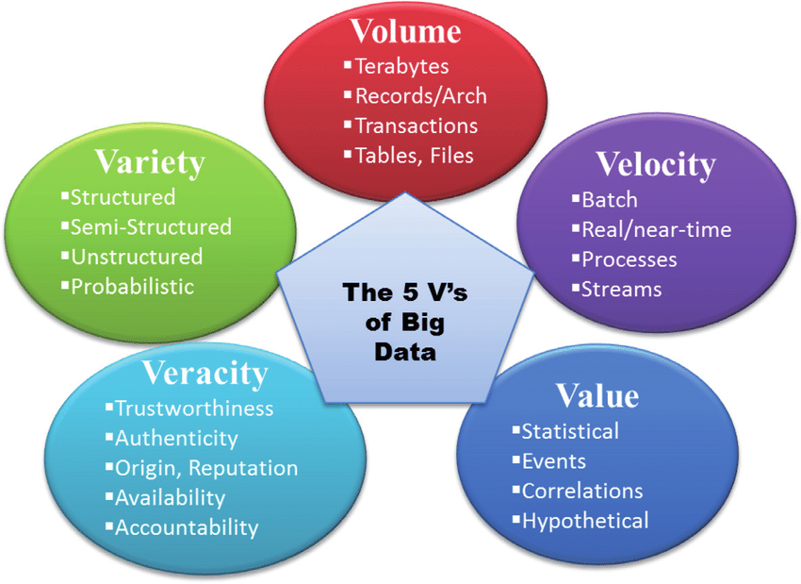
Introduction is Big Data?
Big Data refers to extremely large and complex datasets that are beyond the ability of traditional data processing tools to capture, store, manage, and analyze efficiently.
Characteristics of Big Data?

Slide 17
The Importance of Big Data
Decision Making: Better decision-making processes through analytics.
Efficiency: Improved operational efficiency.
Innovation: Drives innovation and new product development.

Slide 18
Sources of Big Data
Social media,
transactional data,
sensor data,
machine-generated data, etc.

Slide 19
Big Data Technologies
Hadoop: Framework for distributed storage and processing.
Spark: Fast data processing engine.
NoSQL Databases: MongoDB, Cassandra, etc.
Data Warehousing: Snowflake, Redshift

Slide 20
Big Data Analytics
Big data analytics refers to the systematic processing and analysis of large amounts of data and complex data sets, known as big data, to extract valuable insights.
Big data analytics allows for the uncovering of trends, patterns and correlations in large amounts of raw data to help analysts make data-informed decisions.
This process allows organizations to leverage the exponentially growing data generated from diverse sources, including internet-of-things (IoT) sensors, social media, financial transactions and smart devices to derive actionable intelligence through advanced analytic techniques.

Slide 21
Descriptive Analytics​
"What happened?" Uses historical data to understand past events​
Diagnostic Analytics​
"Why did it happen?" Identifies causes behind outcomes​
Predictive Analytics​
"What will happen?" Uses statistical models and forecasts to predict future events​
Prescriptive Analytics​
"How can we make it happen?" Recommends actions based on data

Slide 22
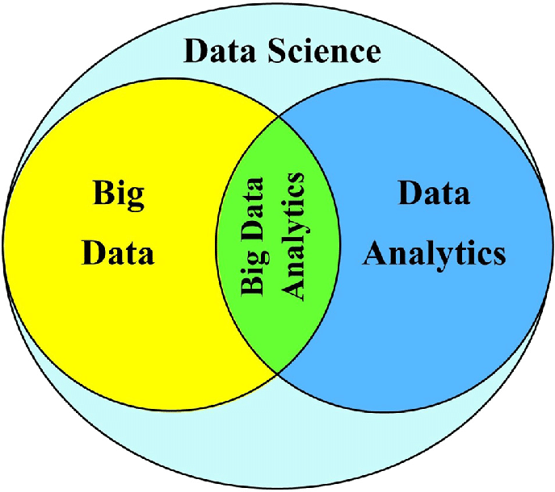
Relationship Between Big Data, Data Science and Data Analytics

Slide 23
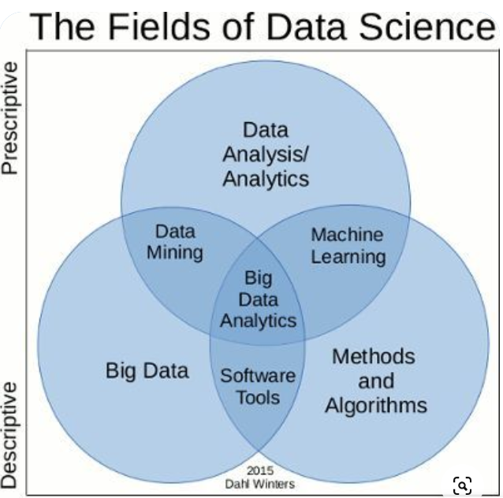

Slide 24
Datafication?

Slide 25
What is Datafication?
Datafication refers to the process where daily interactions of living things can be rendered into a data format and put to social use
Datafication is the process of converting an organization into a data-driven enterprise using a variety of tools, technologies, and techniques.
Datafication refers to the fact that This transformation involves collecting, measuring, and analyzing data from different sources, including social interactions, physical movements, business processes, and more.
The data is then used to inform decision-making, optimize processes, and create new products or services.

Slide 26
Examples
Let's take social media platforms like Facebook or Instagram as an example.
These platforms gather and monitor data about friendships to market goods and services to us and provide surveillance services to organizations, which in turn alters our behavior.
We also see daily promotions on these platforms as a result of the monitored data
By using datafication to inform content rather than recommendation systems, this model uses data to redefine how content is created.

Slide 27
Examples
Other industries, though, do actively use the datafication process.
Insurance: Data used in insurance to update business models and risk profiles.
Banking: Information used to determine a person's creditworthiness and likelihood of repaying a loan.

Slide 28
Benefits of Datafication
Enhanced Decision-Making : Data-driven insights lead to more informed decisions.
Operational Efficiency: Streamlining processes and reducing costs
Innovation and Growth: Creating new products, services, and business models.
Personalization: Tailoring experiences and offerings to individual preferences.

Slide 29
Skill Sets for Data Science

Slide 30
Core Technical Skills
Programming Languages
    Python: Widely used for data analysis, machine learning, and visualization.
    R: Preferred for statistical analysis and graphical representation.
    SQL: Essential for managing and querying relational databases.
Data Manipulation and Analysis
    Pandas: Python library for data manipulation and analysis.
    NumPy: Library for numerical computing in Python.
    Excel: Fundamental tool for data analysis and visualization.

Slide 31
Machine Learning and AI
Understanding of Algorithms
    Supervised Learning: Regression, classification.
    Unsupervised Learning: Clustering, dimensionality reduction
    Reinforcement Learning: Algorithms for decision-making.
Frameworks and Libraries
    Scikit-Learn: Machine learning library in Python.
    TensorFlow: Open-source platform for machine learning and AI.
    Keras: High-level neural networks API.

Slide 32
Data Visualization
Tools and Libraries
    Matplotlib: Plotting library in Python.
    Seaborn: Statistical data visualization library in Python.
    Tableau: Business intelligence and data visualization tool.
    Power BI: Microsoft tool for interactive data visualization.

Slide 33
Data Engineering Skills
Data Management
    Database systems: SQL, NoSQL.
    ETL Processes: Extract, transform, load data workflows.
Big Data Technologies
    Hadoop: Framework for distributed storage and processing.
    Spark: Engine for big data processing.
Cloud Platforms
    AWS, Google Cloud, Microsoft Azure: Cloud-based data services and tools.

Slide 34
Business and Domain Knowledge
Understanding Business Context
    Translating business problems into data science projects.
    Communicating findings to non-technical stakeholders.
Domain Expertise
    Specializing in a particular industry: healthcare, finance, retail, etc.
    Using domain knowledge to enhance data analysis and insights.

Slide 35
Soft Skills
Communication
    Presenting complex data insights in a clear and compelling manner.
    Writing reports and documentation for varied audiences.
Collaboration
    Working effectively in multidisciplinary teams.
    Collaborating with data engineers, analysts, business stakeholders.
Critical Thinking and Problem-Solving
    Analyzing problems from multiple perspectives.
    Developing innovative solutions and hypotheses.

Slide 36
Continuous Learning and Adaptability
Keeping Up-to-Date
    Following the latest research, trends, and technologies in data science.
    Engaging in continuous learning through courses, conferences, and workshops.
Adaptability
    Being open to new tools, methodologies, and challenges.
    Adjusting to the evolving demands of the field.

Slide 37


